Slide 1

North East University Bangladesh
Department of Computer Science and Engineering
1
2D Hand-Drawn Shape Completion
Presenting By,
Eftakhar Ahmed Arnob
ID: 190103020028
Ehtimum Rashed Chowdhury
ID: 190103020026
BSc(Engg) in CSE
4th year 2nd semester
Supervised By,
Khadem Mohammad Asif-uz-zaman
Lecturer
Department of CSE
North East University Bangladesh
Notes:
Hello everyone,
Out thesis topic is 2D hand drawn shape completion.

Slide 2

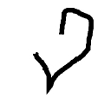
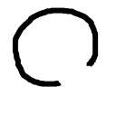
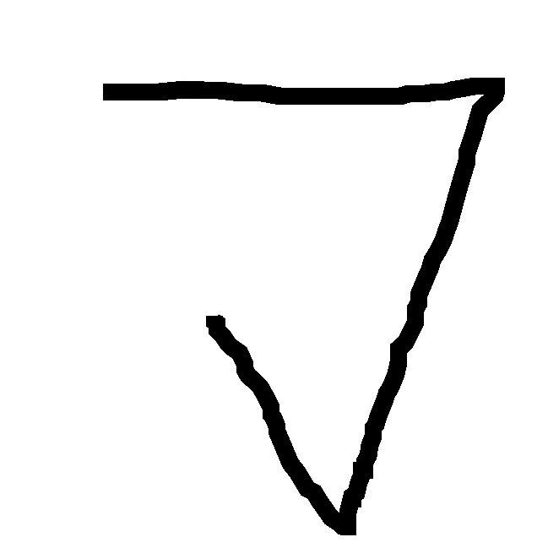
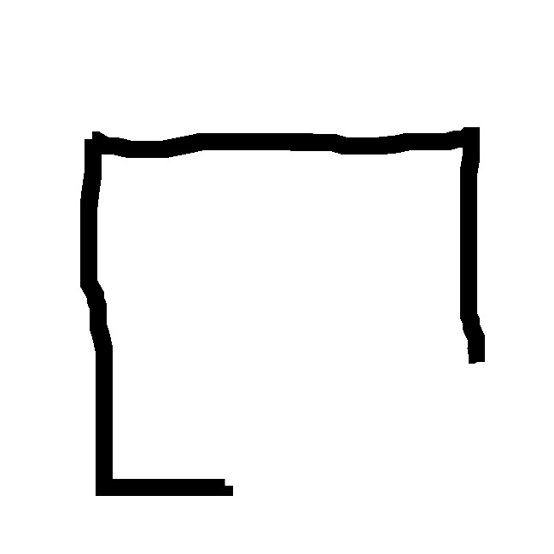
Introduction
2
The objective of our research is to complete two-dimensional hand-drawn sketches containing partially incomplete nonstandard shapes utilizing an encoder-decoder neural network.
Notes:
Our research is about completing partially drawn non-standard shapes using an encoder-decoder network.

Slide 3
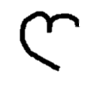
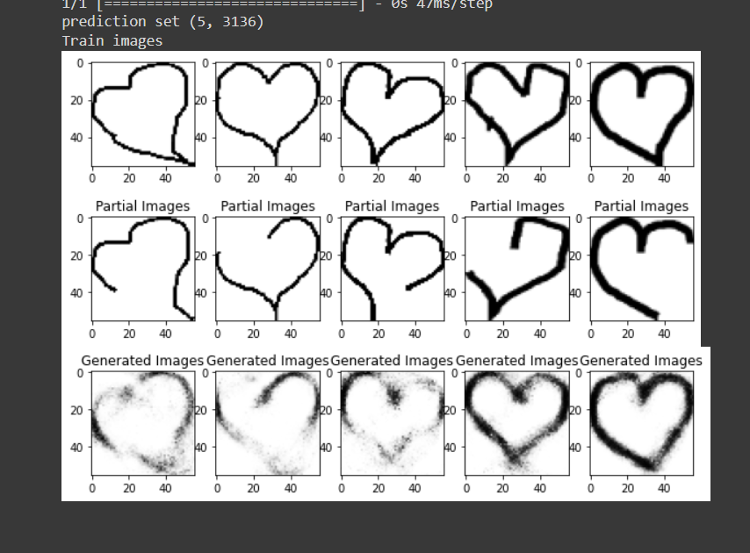

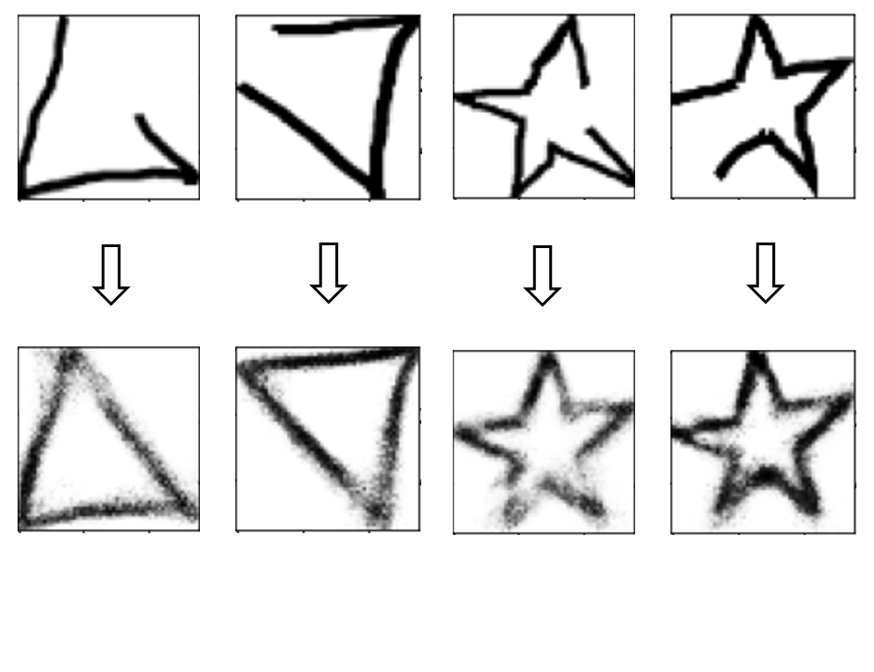
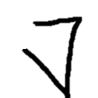
Our Goals
3
Goals:
Generate images from partial hand-drawn inputs.
Maintain consistency between input and output.
Maintain the model's ability to preserve input rotation in output.
Notes:
Our first goal was to generate complete images from partial shapes.
Our second goal was maintaining the consistency of the output with the input.
And the third goal was to preserve the rotation angle and other formfactors of the initial input.

Slide 4
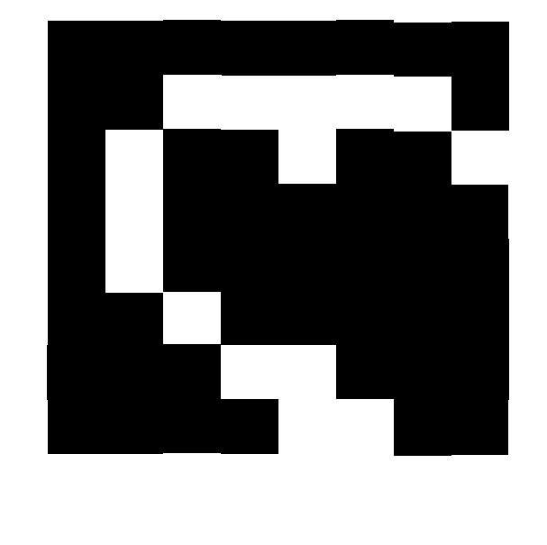
Working Principle of Encoder-Decoder
4
Encoding
Decoding
Initial Input
540x641
Encoded Latent Code
8x8
Generated Output
56x56
Encoder
Decoder
Encoder: Compresses input image to a lower-dimensional latent code.
Latent code: Compressed representation of the input.
Decoder: Expands latent code to the output image.
Loss function: Compares output to the target image.
Optimization: Minimizes loss for accurate image generation.
Notes:
In our method, we initially researched on the encoder-decoder model.
Here’s a diagram that briefly shows how an encoder-decoder works. The encoder compresses the input image into a lower-dimensional latent code. The decoder takes that latent code and expands it into an output image. The loss function compares the generated output with the true shape and calculates the loss. Then this loss parameter is used to optimize the neural network model.

Slide 5
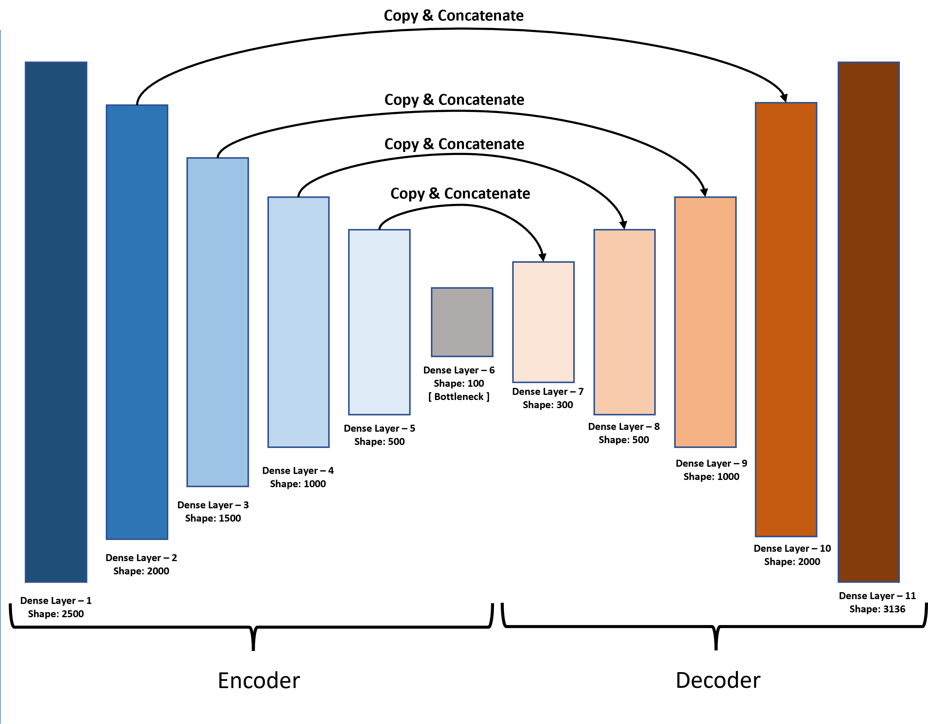
Our Method
5
Adopted an encoder-decoder network to attain research goals.
Researched & Developed the network model.
Composed a custom dataset of 900 samples of partially incomplete and 900 corresponding complete hand-drawn nonstandard shapes per class.
Trained the model using the dataset.
Evaluated model performance using an unknown dataset consisting of more than 100 samples of partial images collected from various users.
Notes:
We developed an initial model and tested it with various data and parameters. After testing, we have find out that the type of work, we are trying to accomplish, encoder-decoder will be perfect and most efficient.
After that we built the training dataset and trained our model. After training, we tested our model’s performance using more than 100 partially incomplete shapes collected from various users. After completing these shapes, we evaluated the performance from the perspective of human observation.

Slide 6
Our Encoder-Decoder Architecture
6
Copy & Concatenate
Encoder:
Layer 1 - Type: Dense - Shape: 2500 - Activation: LeakyRelu
Layer 2 - Type: Dense - Shape: 2000 - Activation: LeakyRelu
Layer 3 - Type: Dense - Shape: 1500 - Activation: LeakyRelu
Layer 4 - Type: Dense - Shape: 1000 - Activation: LeakyRelu
Layer 5 - Type: - Shape: 500 - Activation: LeakyRelu
Layer 6 - Type: Dense - Shape: 100 - Activation: LeakyRelu
Decoder:
Layer 1 - Type: Dense - Shape: 300 - Activation: LeakyRelu
Layer 2 - Type: Dense - Shape: 500 - Activation: LeakyRelu
Layer 3 - Type: Dense - Shape: 1000 - Activation: LeakyRelu
Layer 4 - Type: Dense - Shape: 2000 - Activation: LeakyRelu
Layer 5 - Type: Dense - Shape: 3136 - Activation: Sigmoid
Copy & Concatenate
Copy & Concatenate
Copy & Concatenate
Dense Layer – 6
Shape: 100
[ Bottleneck ]
Dense Layer – 7
Shape: 300
Dense Layer – 5
Shape: 500
Dense Layer – 8
Shape: 500
Dense Layer – 4
Shape: 1000
Dense Layer – 9
Shape: 1000
Dense Layer – 3
Shape: 1500
Dense Layer – 2
Shape: 2000
Dense Layer – 10
Shape: 2000
Dense Layer – 1
Shape: 2500
Dense Layer – 11
Shape: 3136
Encoder
Decoder
Notes:
This is our final encoder-decoder model that consists of 6 encoder layers with a decreasing order of shapes. The decoder has 5 layers with an increasing order of shapes. All the layers are fully connected dense layer with activation of LeakyRelu, only the last layer has activation of sigmoid.

Slide 7
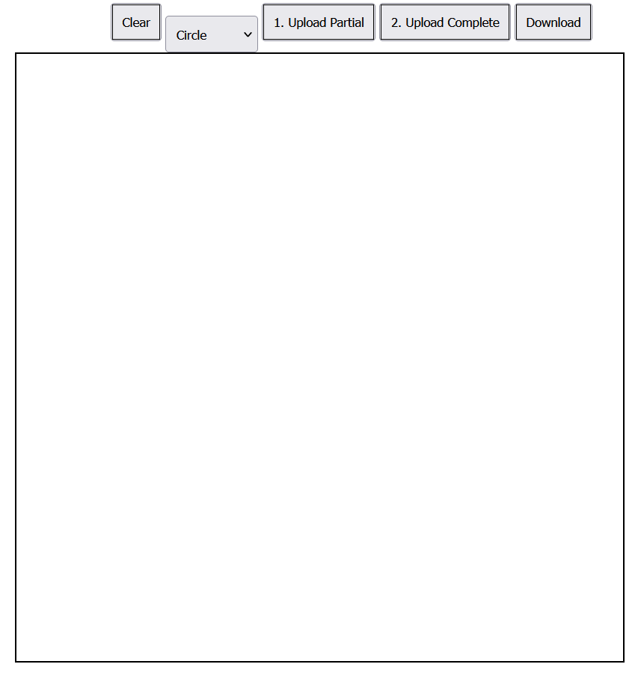
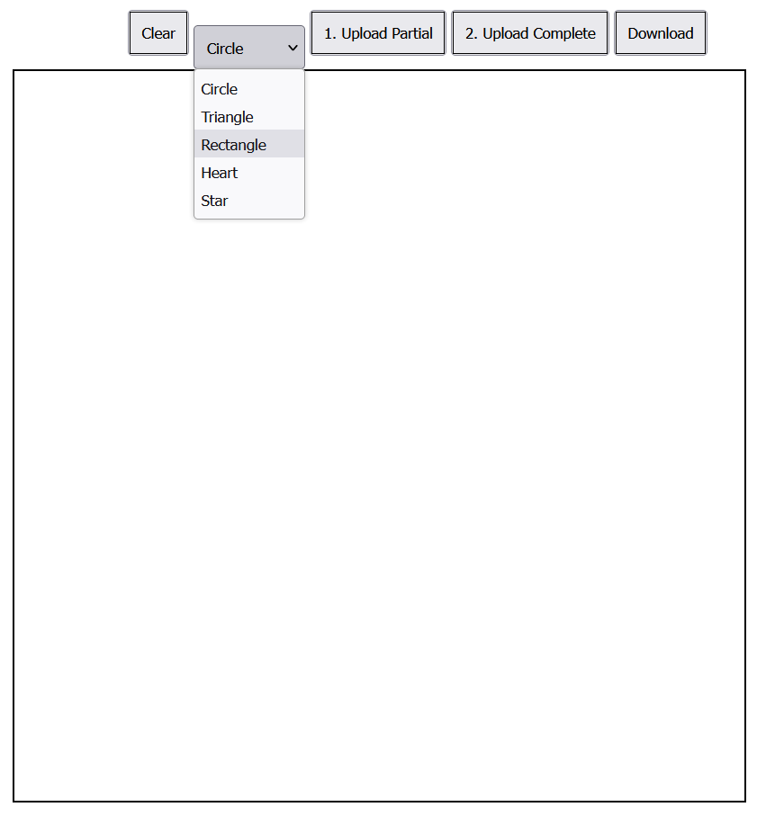
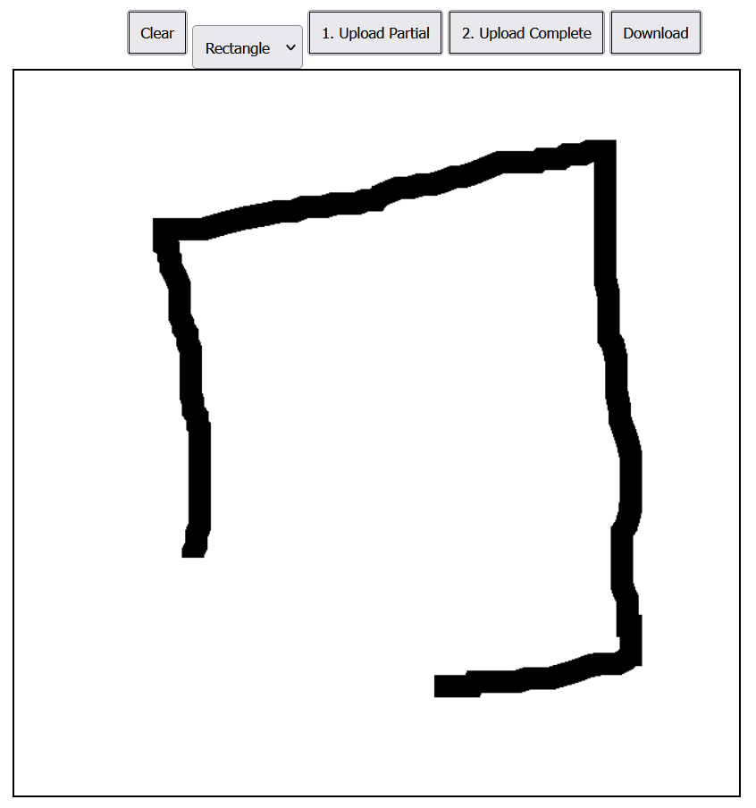
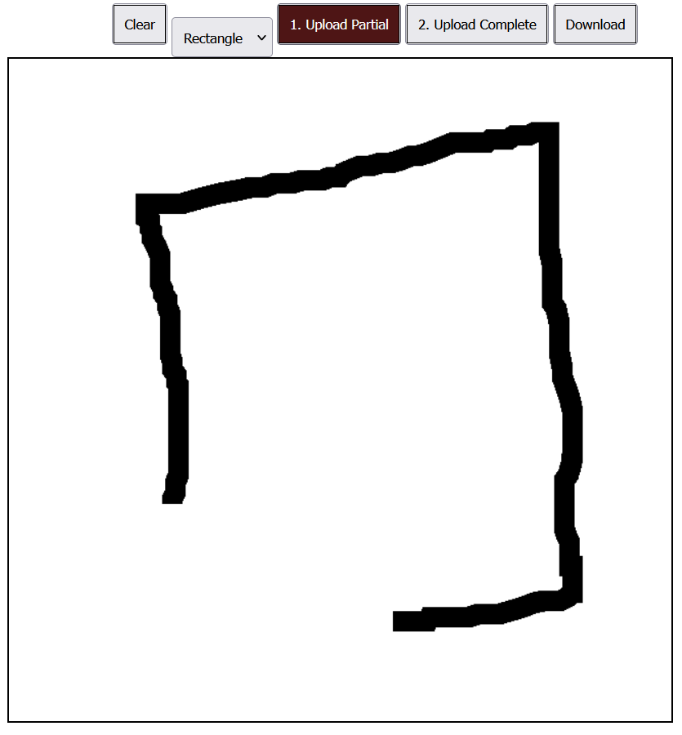
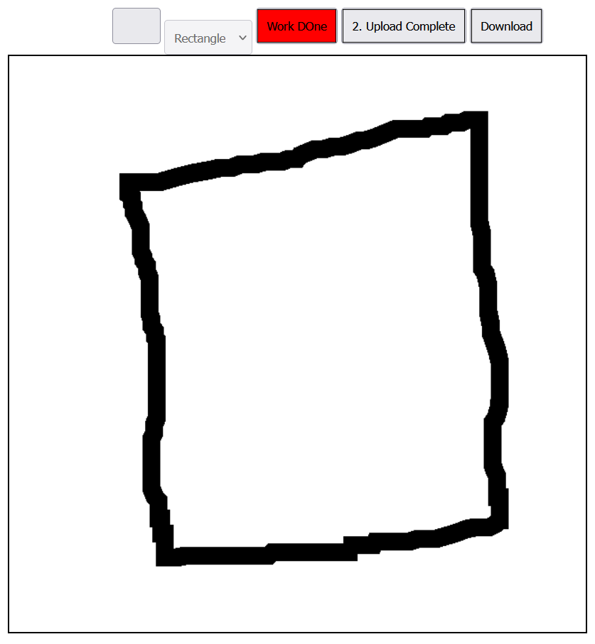
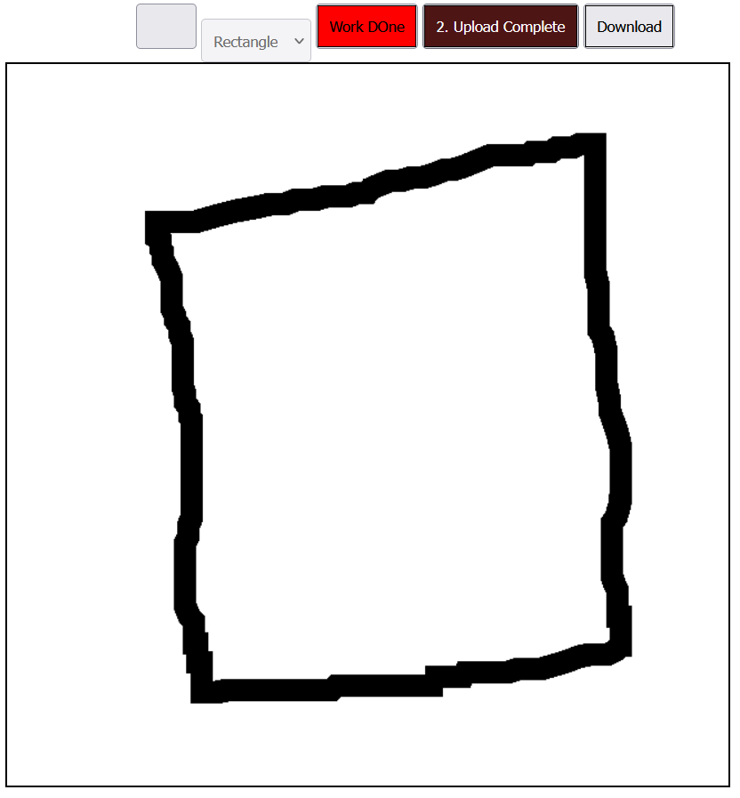
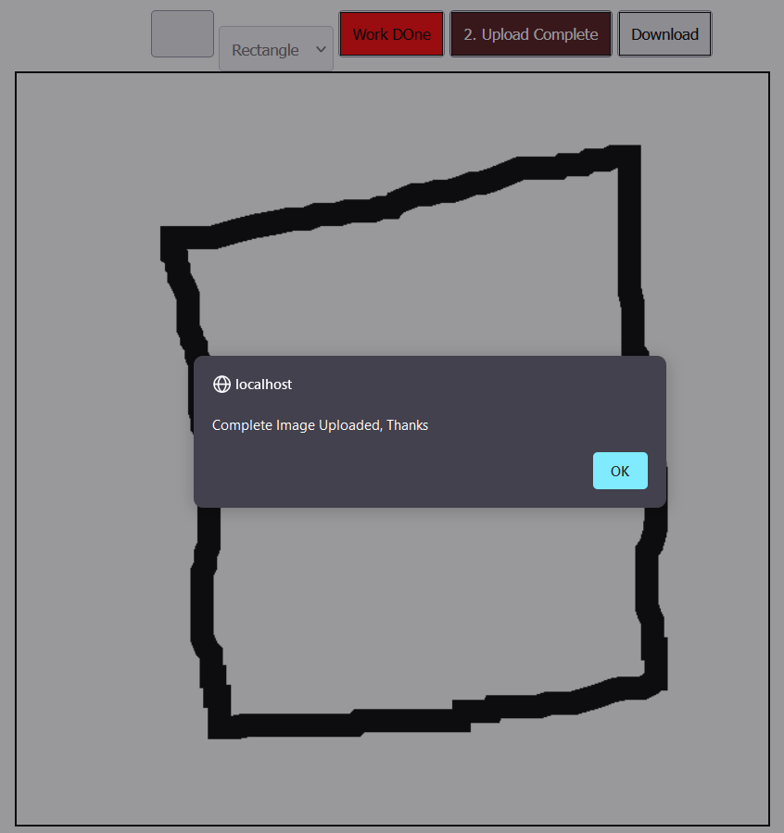
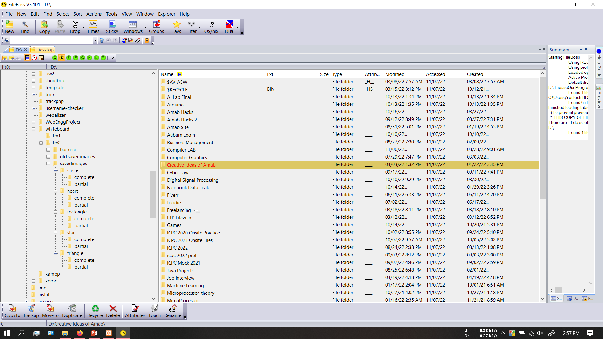
Developed Web-Application For Dataset Building
7
1. App Interface
2. Select Class
3. Draw partial Shape
4. Upload partial Shape
5. Complete The Shape
6. Upload Complete Shape
7. Upload Confirmation
8. Saved Dataset Structure
Notes:
Building a large dataset for training was hard, so we developed a web application to semi-automate the dataset building.

Slide 8
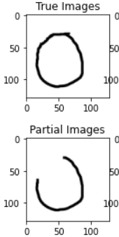
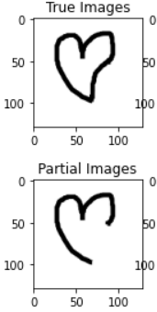
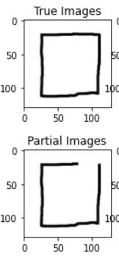
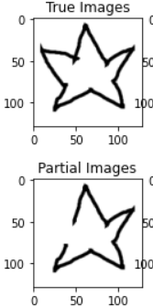
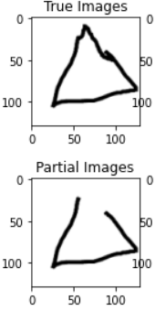
Our Dataset
8
Classes : Circle Heart Rectangle Triangle Star
True Images: Shapes that were manually completed from corresponding partial shape images.
Partial Images: Partially drawn shapes by human.
Notes:
Using the web application we build a dataset of 900 partial images and 900 corresponding complete images for 5 classes. Total of 9000 images.

Slide 9
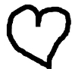
Training Phase
9
Steps:
Sample partial shape from the training dataset.
Encode to get latent code.
Generate output with Decoder and random noise.
Complete shape manually.
Compare output and manual shape with the loss function.
Minimize loss by calculating it.
Latent Code
Encoding
Input: Partially Incomplete
Shape
Decoding
Optimization
Optimization
Loss =
-1/N * ∑( y_true
* log(y_pred)
+ (1-y_true)
* log(1-y_pred))
True Shape:
Manually Completed
Output:
Decoded Generation
Loss Function
Notes:
On the training phase of the network model, we encoded and decoded a partial shape to generate a completed image. Then the generated image is compared with the corresponding true shape to calculate the loss. We used the binary cross-entropy loss function. The calculated loss is then used to optimize the neural network to generate a more accurate result on the next iteration. The cycle continued until the training is finished. We used total 1000 epochs per class and training for each class took around 20 minutes of time.

Slide 10
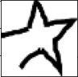
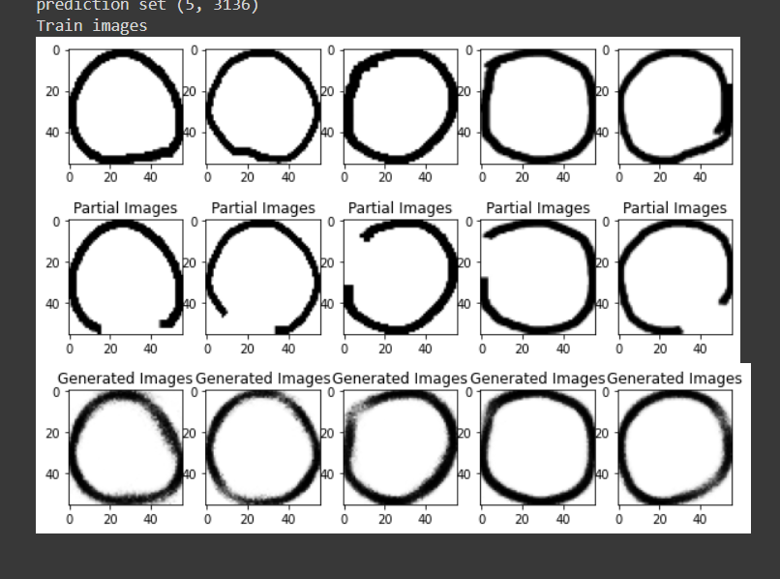
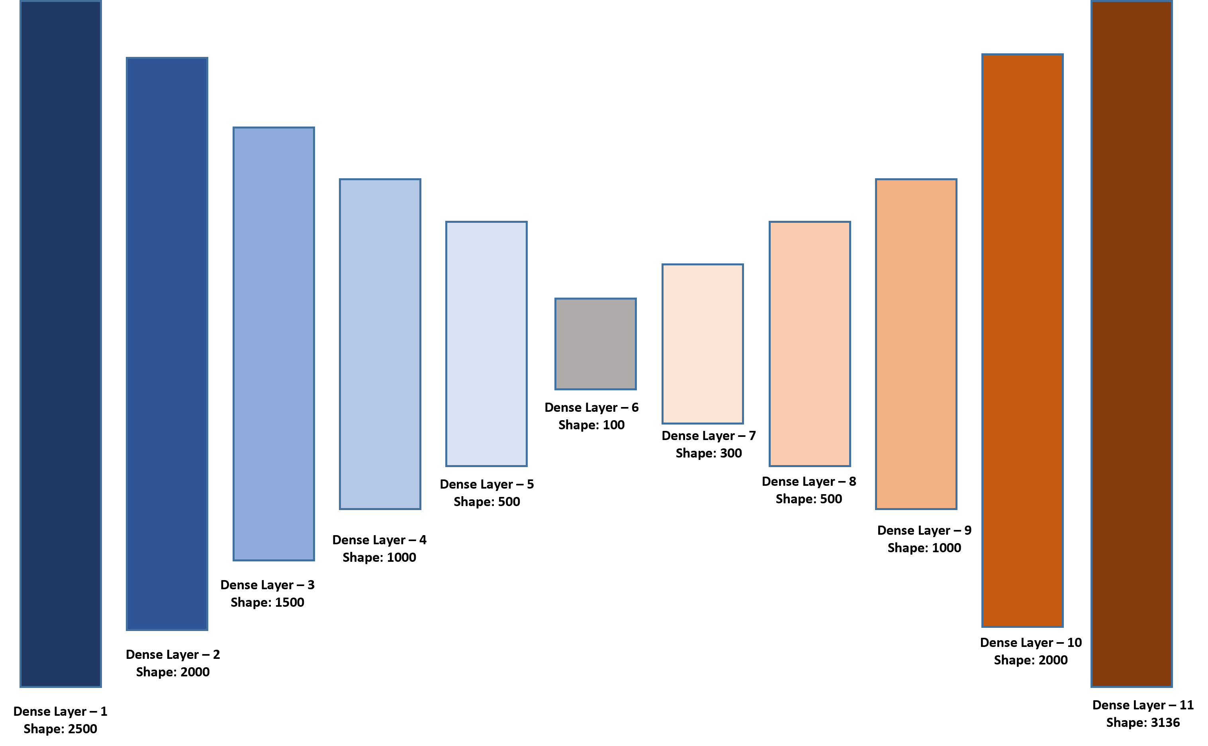

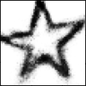
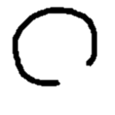
Generation Phase
10
Steps:
Collected 100+ partial shapes with random form factors from various users as inputs
Completed partial shapes using our trained model.
Evaluated completion through human observation.
Generation Model
Preprocessed Dataset
Pre
Processing
Generation
Unknown Partial Dataset
Generated Output
Notes:
On the generation testing, we collected partially drawn 100 shapes from various people in various rotation and form factors. Then we preprocessed the input a little bit.
After that, we fed the data to our model to predict the completed images.

Slide 11
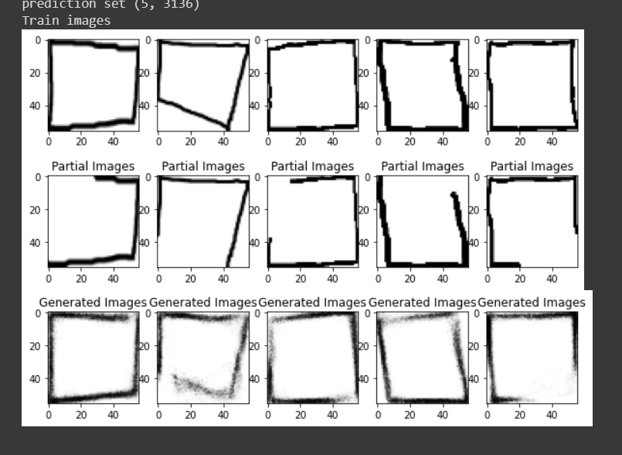
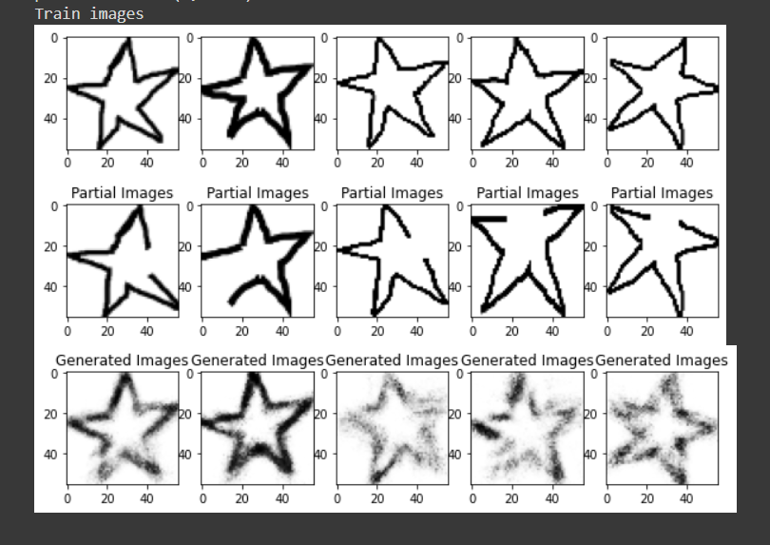
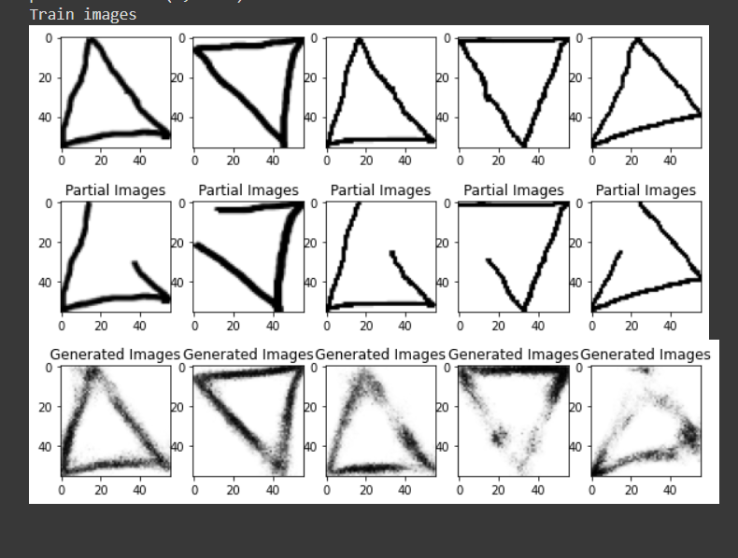
Results
11
Result:
Conducted image generation and completion using 100 partially drawn images from various individuals.
Images varied in size and shape trajectory, including odd shapes.
73 images were completed with high accuracy (90-95% average completion rate).
15 images had an accuracy of approximately 50%.
12 images were considered "garbage generation" as they only had an accuracy of around 30%.
Overall average accuracy: 78%.
Notes:
The result we got from the generative completion was impressive. Almost all the shapes missing trajectory were predicted perfectly. From 100 images, 73 images were completed with more than 90% accuracy by human observation. The other 15 images had a completion accuracy of 50% and the rest 12 images were around 30% accurate.
After calculation, the average accuracy of our system was 78%.

Slide 12
Conclusion
12
Our research suggests that for simple tasks such as completing missing parts of basic shapes, encoder-decoder models are more accurate and efficient than GANs, despite the latter's ability to generate diverse images.
← END →
Notes:
from our research, we find out that, although GANs can generate very diverse images but for simpler task as completing missing part of a basic shape, encoder-decoder is more accurate and efficient.

